Slide 1
Preventing
Opioid
Abuse
Team Artificial Intel-Agents
Corey Duncan | Ayodeji Ejigbo | Sarah Roe

Slide 2
Presentation Outline
01
02
03
04
Problem Statement
Why Is This Important?
Objectives
Ethical Considerations
05
EDA & Models
06
Conclusions
07
Next Steps
08
Works Cited

Slide 3
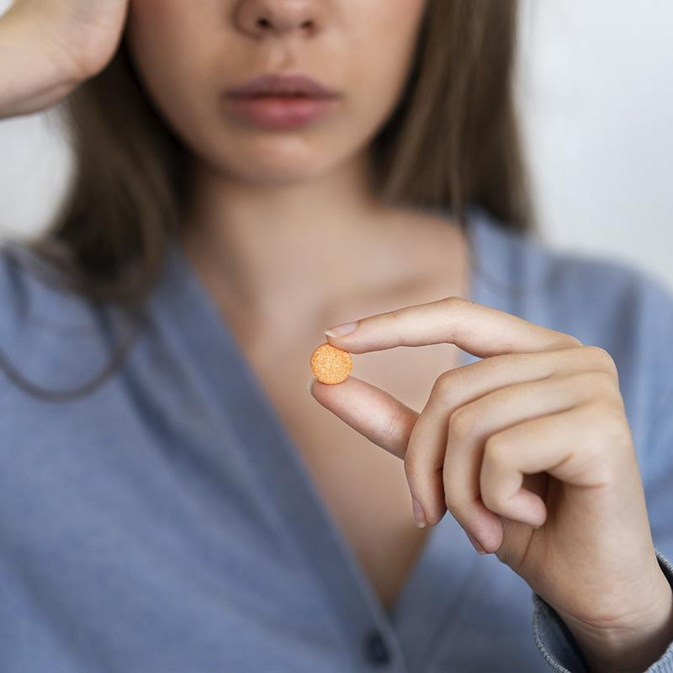
Problem Statement
01
Is it possible to build a machine learning model that helps us identify which patients are likely to abuse prescription pain medications using a patient’s drug usage history?
Can this information be used to help reduce the chances of patients becoming addicted while simultaneously helping patients at lower risk not see a lapse in their medication?

Slide 4
02
Why is this Important?
Many addictions start with prescription opioids.
Due to the high cost and difficulty of obtaining prescription pain medication, many people turn to cheaper, stronger opioids.
Fentanyl is one such opioid, that has killed more young Americans (18-45) than Covid-19 in 2021-2022.
In America, fentanyl fatally poisons someone every 8.57 minutes, for 175 deaths per day.

Slide 5
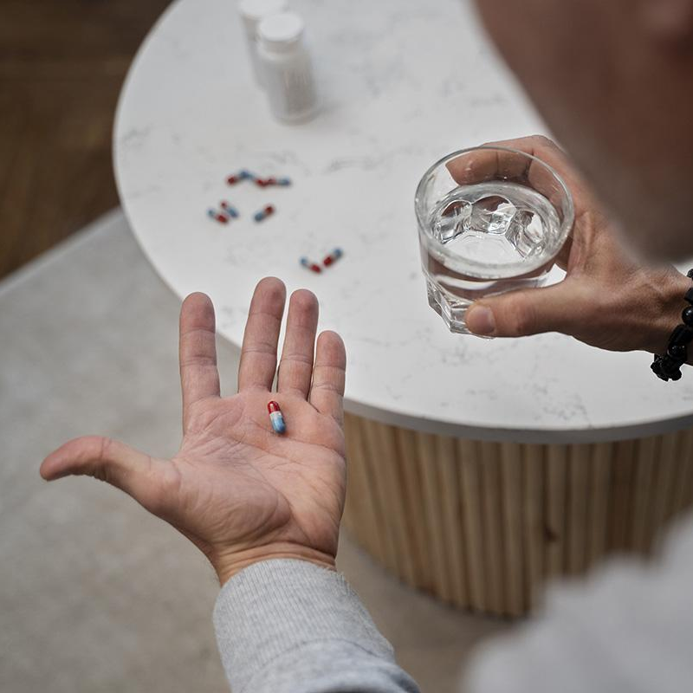
Objective
03
Our project aims to develop a machine learning model to predict the likelihood of a patient abusing pain medications. This information would allow doctors to:
Make decisions on what types of pain meds to give, and how much at a time
Prevent cases of addiction and/or relapse
Intervene early, create treatment plans and overall improve quality of care for all patients

Slide 6

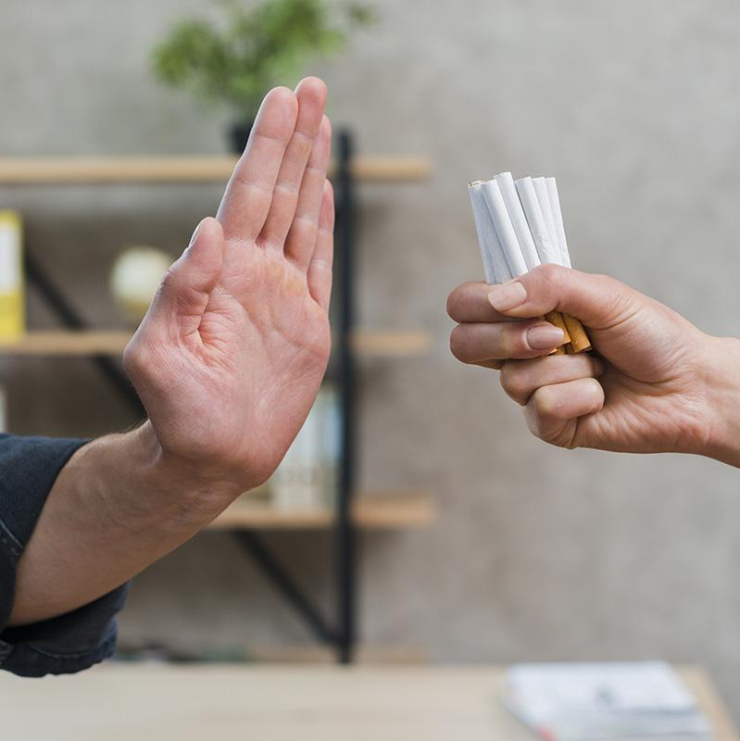
Ethical Considerations
04
Outright denying narcotic pain medications based on potential abuse is wrong and not our model's goal. Instead, we aim to aid doctors in making informed decisions on pain medication types and dosages, providing these benefits:
Low risk patients could receive more medication at once so they don’t see a lapse
1
Moderate risk patients could be given less medication upfront and be offered additional support/monitoring
2
Severe risk patients could be offered non-narcotic alternatives
3

Slide 7
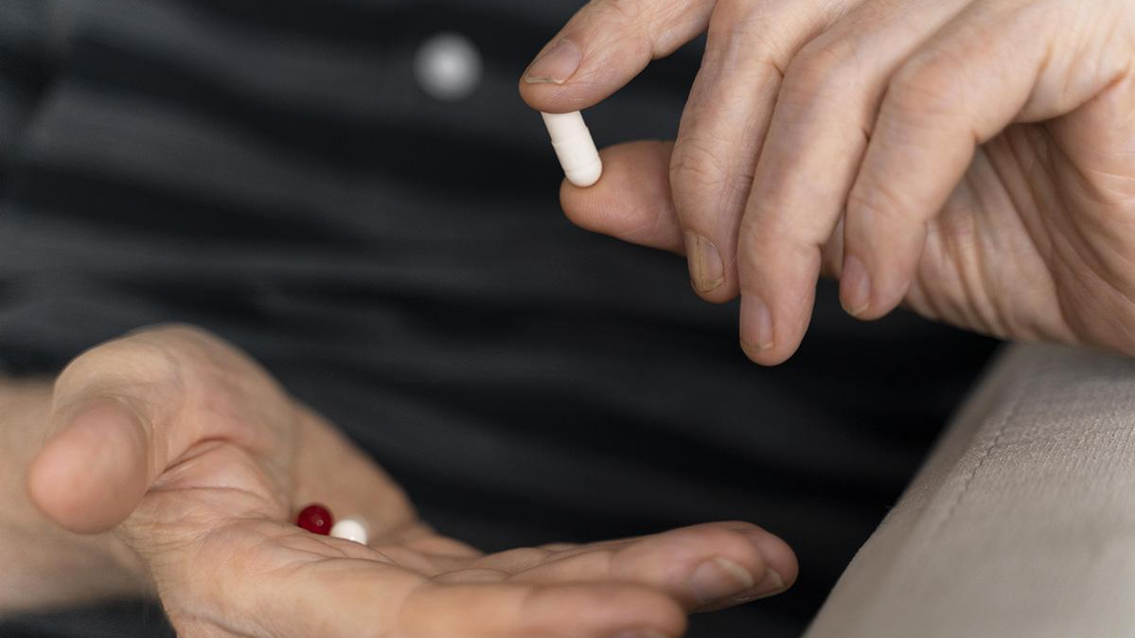
EDA & Models
05

Slide 8
EDA - Corey
Missing/Mislabeled Data
Checked Correlations
Dropped columns with incorrect values
Explored which features were worth using in our model
01
02
03
04
Imbalanced Classes
Interaction Terms
Used oversampling of minority class to fix imbalance
Created new columns such as Uppers, Downers, Overall Health

Slide 9
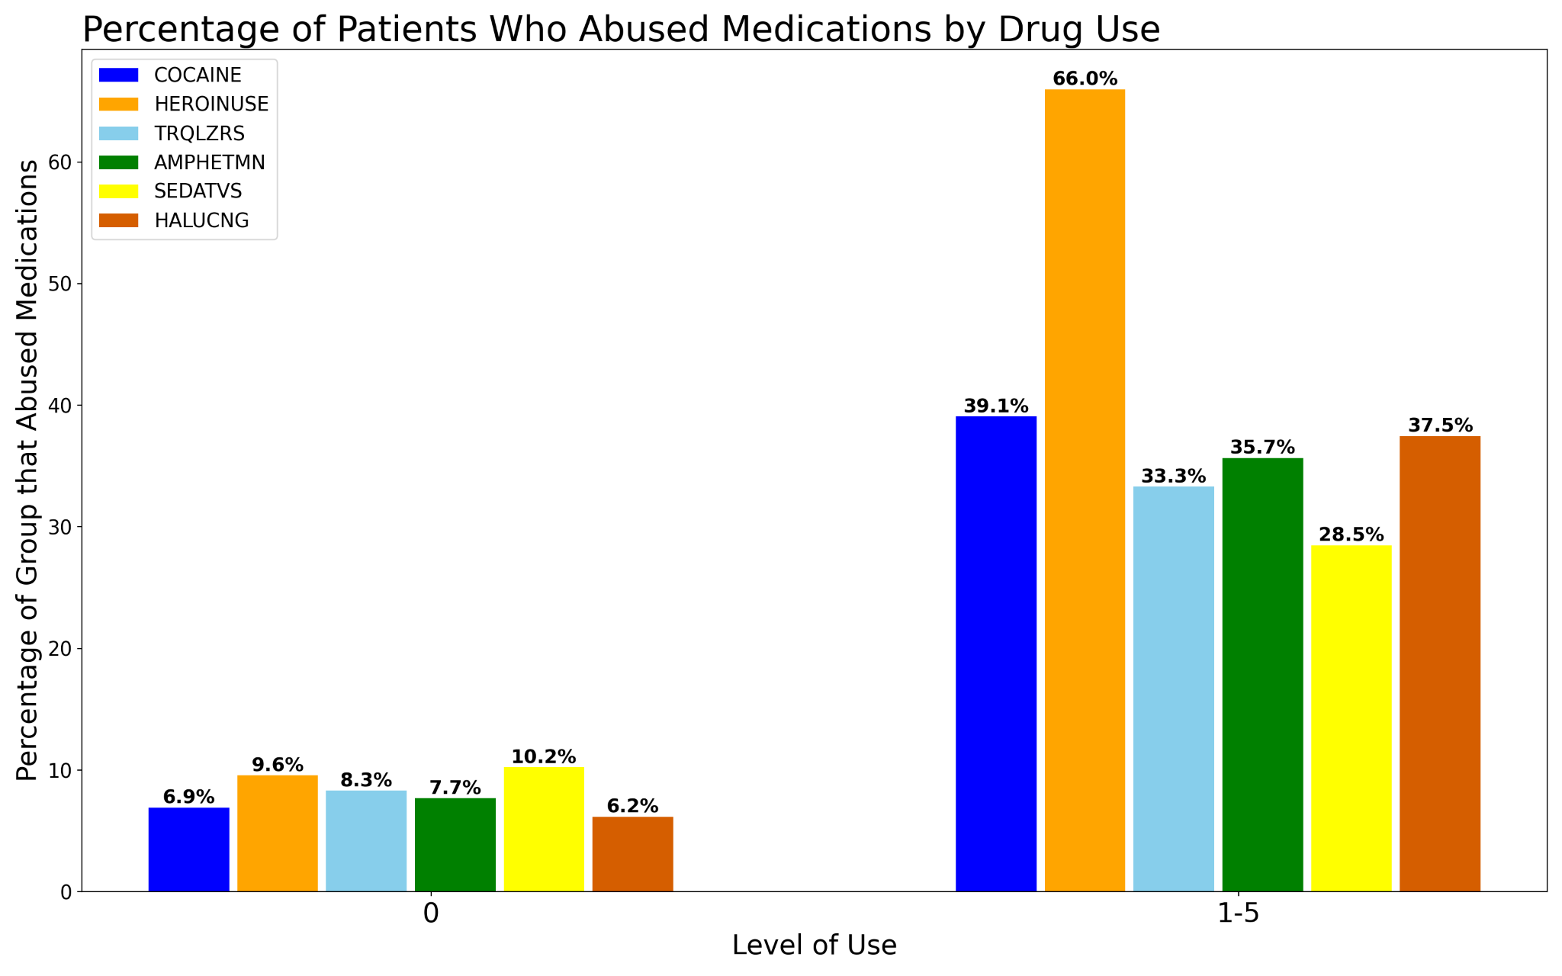
What role does recreational drug use play?
This graph shows the percentage of patients who abused pain medications and their drug use in the past year.
66% of patients with reported heroin use in the last year also abused pain medications.

Slide 10
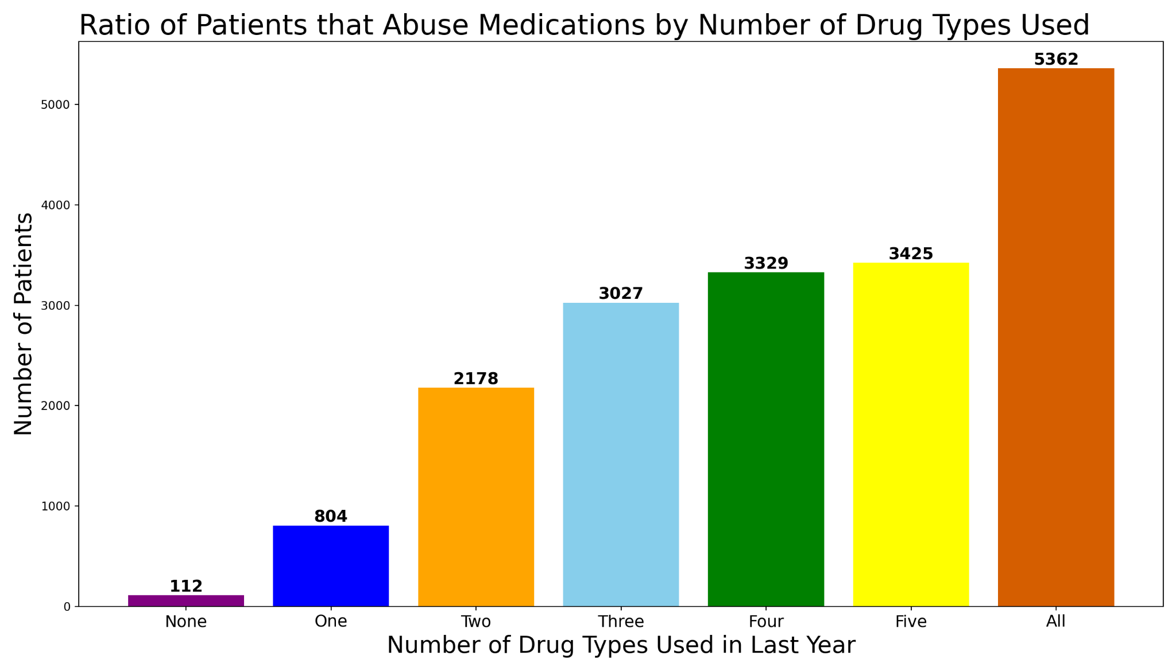
Does level of use make a difference?
This graph represents all our patients who abused pain medications, grouped by how many drug types they’ve abused in the last year.

Slide 11
Models - Corey
Tried a variety of models, including
Random Forest Variations (0.888, Best)
Logistic Regression (0.749)
Neural Nets (0.758)
SVM (N/A)
Voting Classifier Variations w/ Gradient Boost, Extreme Gradient Boost, Random Forest, etc. (0.847)

Slide 12
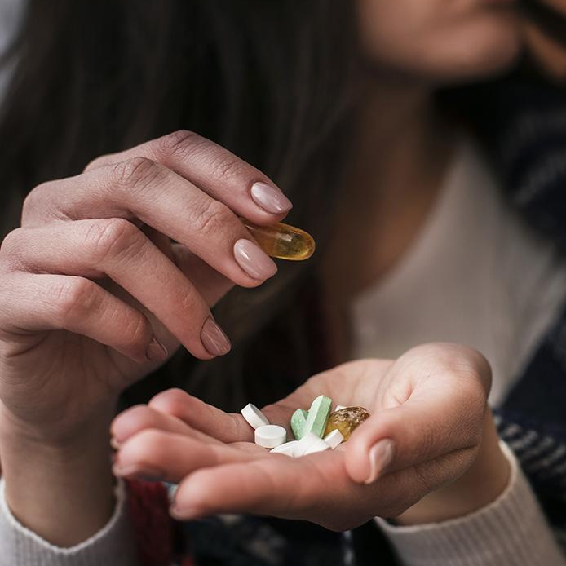
Random Forest w/ PCA & GridSearch
Best Model
Include interaction terms
Included features with missing values
Standard Scaled
GridSearchCV for best params
PCA
Score: 0.888 | Predicted No Abuse | Predicted Abuse
Actual No Abuse | 35093 | 3006
Actual Abuse | 5486 | 32455

Slide 13
EDA - Ayo
Missing/Mislabeled Data
Checked Correlations
Dropped columns that had incorrect values
Explored potential variables to focus on
01
02
03
04
05
Imbalanced Classes
Feature Engineering
Principal Component Analysis
Used SMOTE to fix imbalance
Creating new features to improve performance
Fit a PCA model to understand what variables were significant

Slide 14
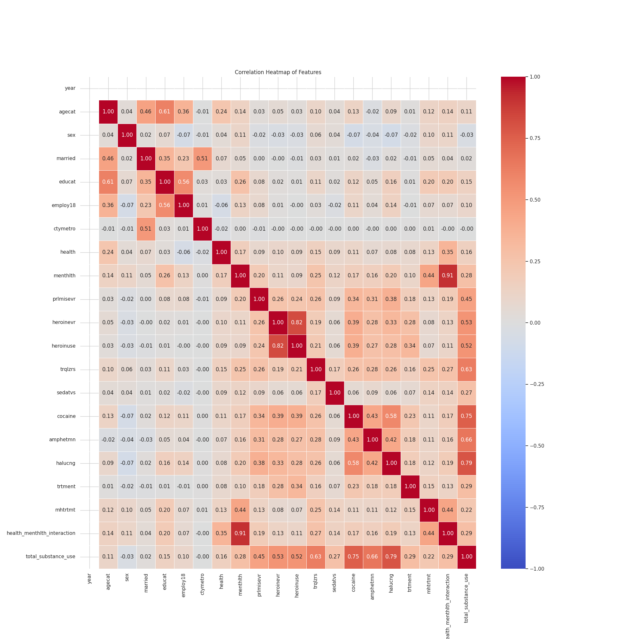
Heatmap showing the relationship between all variables

Slide 15
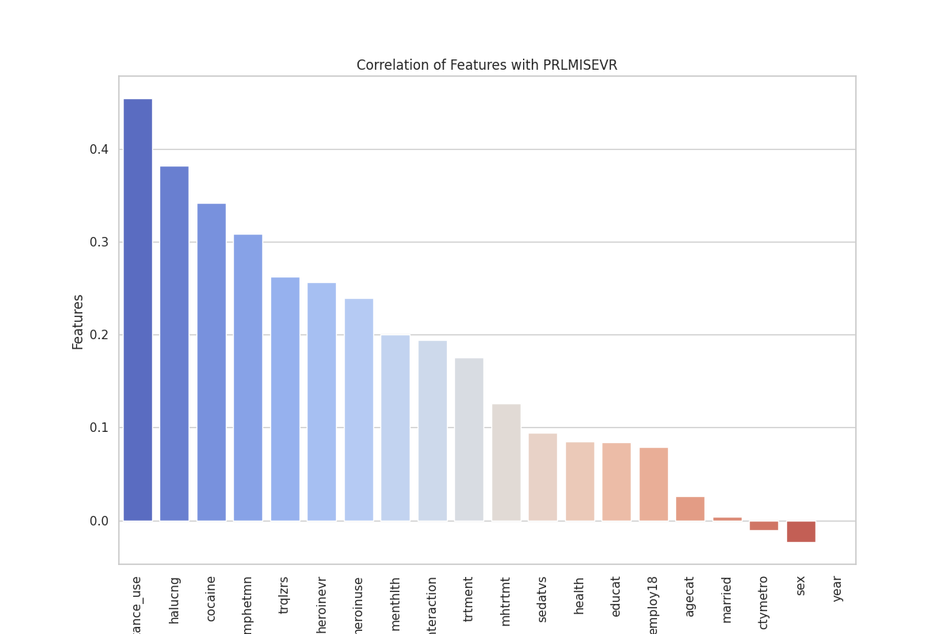
HOW DOES EACH FEATURE CORRELATE WITH DRUG MISUSE SEVERITY?

Slide 16
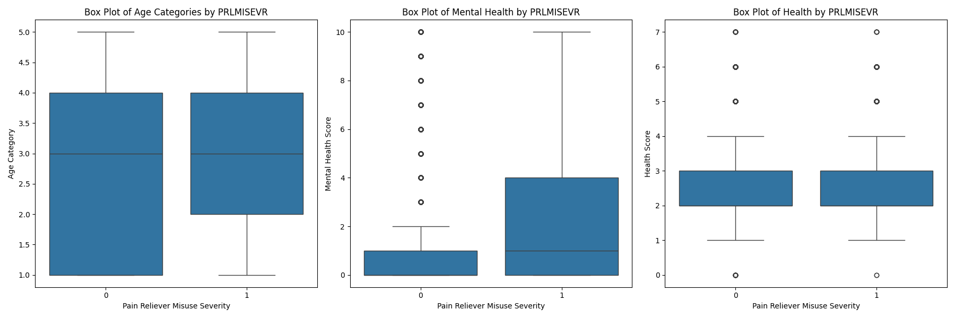
Distribution of age categories, health, and mental health scores for different levels of drug misuse severity (`prlmisevr`).

Slide 17
Models - Ayo
LogisticRegression(max_iter=1000) - (0.908)
RandomForestClassifier() - (0.902)
KNeighborsClassifier() - (0.894)
SVM - (0.902)
Neural Nets - (0.903)

Slide 18
Logistic Regression
Best Model
max_iter=1000
PCA (n_components=5)
Precision: 92%
Recall: 89%
F-1 Score = 90.5%

Slide 19
EDA - Sarah
Missing/Mislabeled Data
PCA Feature Importance
Dropped columns that had incorrect values
Fit a PCA model to understand what variables were significant
01
02
03
04
Imbalanced Classes
Checked Correlations
Used bootstrapping to fix imbalance
Explored potential variables to focus on

Slide 20
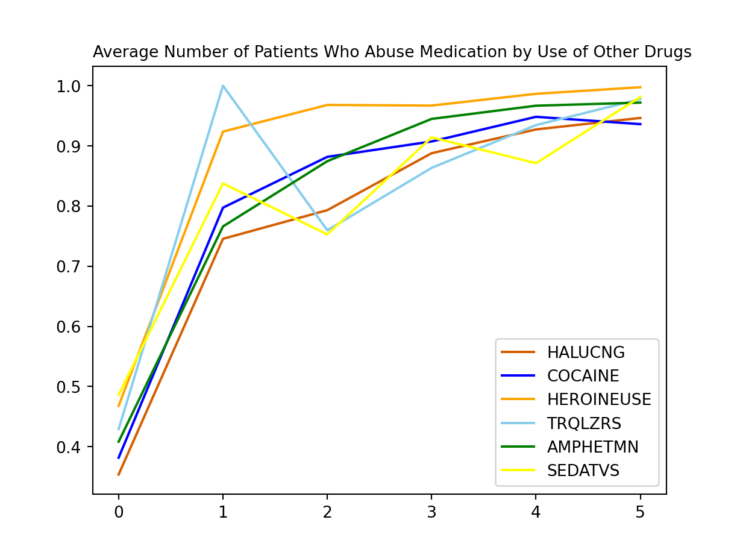
How does Drug Use impact Drug Addiction
This graph shows a general upward trend indicating as amount of drug use increases, the likelihood of becoming addicted to drugs also increases

Slide 21
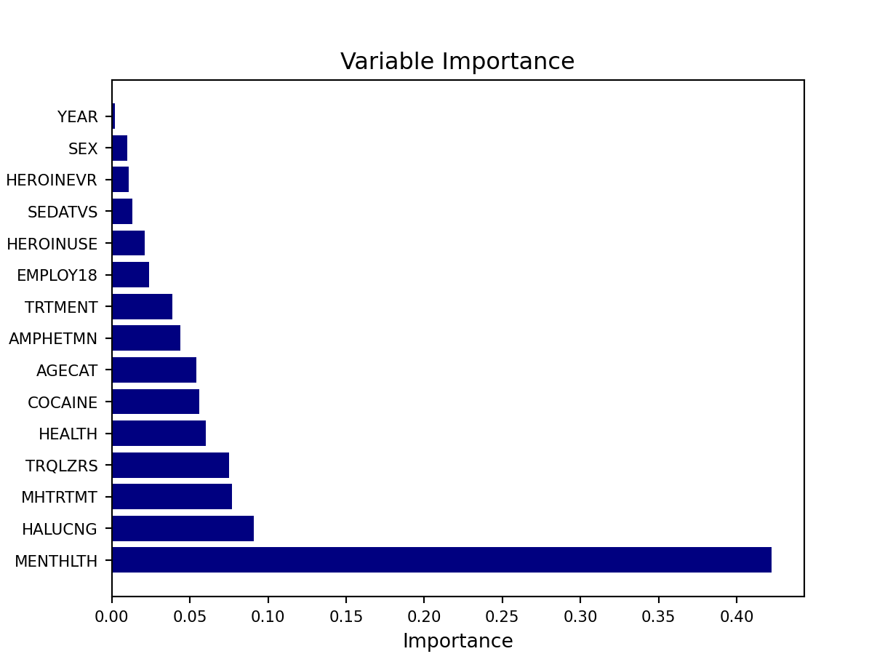
PCA Feature Importance
Mental Health is shown to have the highest feature importance

Slide 22
Models - Sarah
Tried a variety of models, including
Random Forest Variations (0.85, Best)
With/Without PCA
Neural Nets (0.753)
Logistic Regression (0.742)
With/Without PCA
Naive Bayes (0.738)

Slide 23
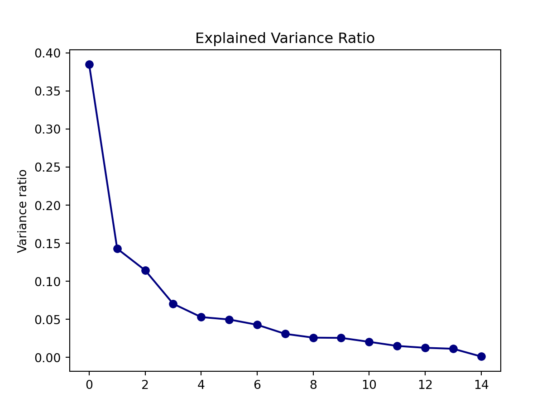
Random Forest w/ PCA
Best Model
N_estimators=600
Max_features=9
Max_depth=30
PCA (n_components=5)

Slide 24
Limitations/Next Steps
Hard to fully understand patterns based solely on self reported data
Understanding the risk of False Negatives
Data set, while large, had some incorrect values
Collecting self-reported pain level to better understand ‘need’
Continually updating and re-fitting to new data

Slide 25
Conclusion
Enhancing Patient Safety
Improving Healthcare Efficiency
Personalized Pain Management
Evidence-Based Decision Making
Reducing Addiction Risk
Opioid Crisis

Slide 26
Work Cited
National Institute on Drug Abuse: Drug Overdose Death Rates https://nida.nih.gov/research-topics/trends-statistics/overdose-death-rates#:~:text=Nearly%20108%2C000%20persons%20in%20the,drugs%20from%201999%20to%202022.
Kaggle Dataset on Opioid Abuse https://www.kaggle.com/datasets/thedevastator/predicting-pain-reliever-misuse-abuse/data
Dataset Documentation: https://zenodo.org/records/2301844#.Y8OqptJBwUE
Opioid Crisis in Young Americans: https://murphy.house.gov/media/press-releases/murphy-fentanyl-killing-more-young-americans-covid-19

Slide 27
Thanks

